Slide 1
The Age of Innocence
By: Edith Wharton

Slide 2
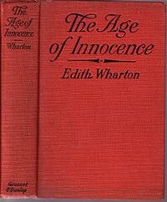
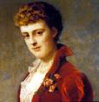
*Setting.
* Conflict.
* Climax.
* Themes.

Slide 3
Setting
*The action of the novel takes place primarily in the early 1870s in New York, but there is brief action in St. Augustine, Florida; Newport Beach, Rhode Island; Boston, Massachusetts; and Paris, France.
*Aside from historical and geographical setting, it is importance to note that The Age of Innocence has a social setting that is both historical and geographical, but that also has its own unique classification.

Slide 4
*Social forces that seem to exist and even breathe independently of time and space govern the New York of the novel. People know what is expected of them and there are invisible boundaries of class and propriety that one must never cross. These social guidelines, which encompass matters of "family" and "form," define late nineteenth century New York as much as any other qualities. The love story between Newland Archer and Ellen Olenska would not be nearly as compelling were it not for the restrictive forces of the social setting that keep them apart and force them to make their ultimate sacrifices in the name of family and society.

Slide 5
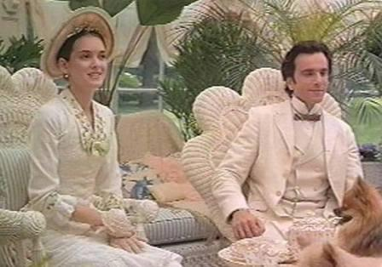
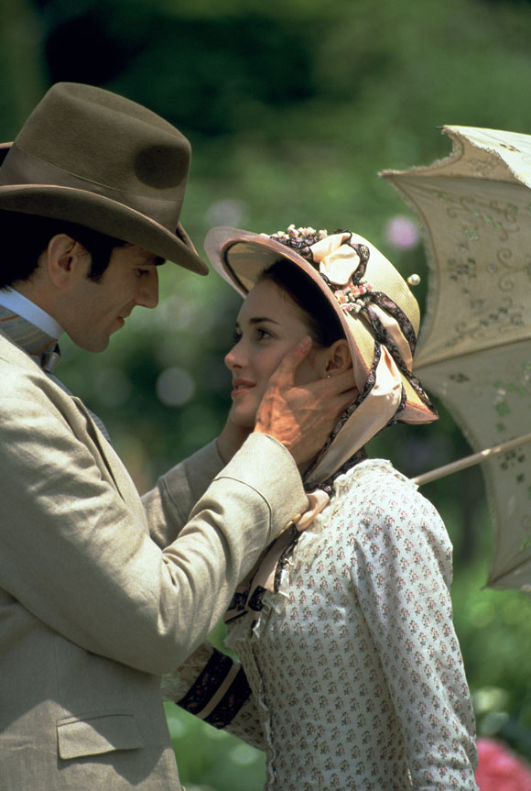

Slide 6
Conflict
*Protagonist :
Newland Archer, a young man who fits perfectly into his small social group and plans to marry a respectable girl and live a respectable life, is the protagonist of the novel. He meets Ellen Olenska and undergoes a change of heart in which he realizes New York society is stifling him. Throughout most of the novel, he struggles with his conflicting desires. In the end, he is restored to society and gives up his passions, but he is content with this choice.

Slide 7
:Antagonist*
The strict norms and conventions of wealthy New York society are restrictive forces that act as antagonists, creating conflict for Newland Archer as well as the other free spirits -- namely, Ellen Olenska, Julius Beaufort, Medora Manson, and Mrs. Struthers.

Slide 8
Climax
*There are several climactic moments in the novel, including the moment Newland Archer realizes he loves the Countess Olenska and wants to marry her instead of marrying May Welland, his fiancée, and the moment he decides to leave his wife and consummate his affair with Ellen.

Slide 9
*The final climactic moment, however, occurs when Newland realizes he cannot do as he longs to. May has told Ellen about her pregnancy and Ellen will no longer carry on the relationship with Newland, nor will she even give him one night. He has been fooling himself into thinking her hesitation can be conquered. In this moment at the end of the novel, Newland must accept the fact that obligations of society and family are too strong; he has been conquered.

Slide 10
Outcome
Order is restored and after some time passes, Newland Archer gains contentment with his place in society. He still thinks of Ellen with passion and fondness, but she is a dream that will never happen. He raises a family with May and even comes to love her. He accepts the fact that certain passions will never be his, and in the end, prefers to keep it this way.

Slide 11
Themes
Major Theme:
The main theme of Edith Wharton's The Age of Innocence is the conflict between the desire of the individual and the conservatism of the group. The novel's title suggests its values: during the age of innocence, people conformed themselves to the dictates of the social code, no matter how much they wanted to take their own measures to ensure their happiness. This choice of the group or the family over the individual is shown in the course of the protagonist's life to be the nobler choice.

Slide 12
Minor Theme :
The minor theme of the novel is the changes society went through over the course of thirty years from the 1870s to the turn of the century. Edith Wharton writes of this change with realism surprisingly free of nostalgia. She writes of both the moral strengths and the moral failings of the old society and she celebrates the new society in choosing a very positive character as its representative.

Slide 13
Names of grope:
Areej Saeed Al –Ghamdi
Afrah Abdullah Al- Ghameeti
Amani Sultan Al –Rougi
Amani Ali Al – Ghamdi
Amal Eid Al – Shlwi

Slide 14



